Slide 1

Project JellyBin

Slide 2
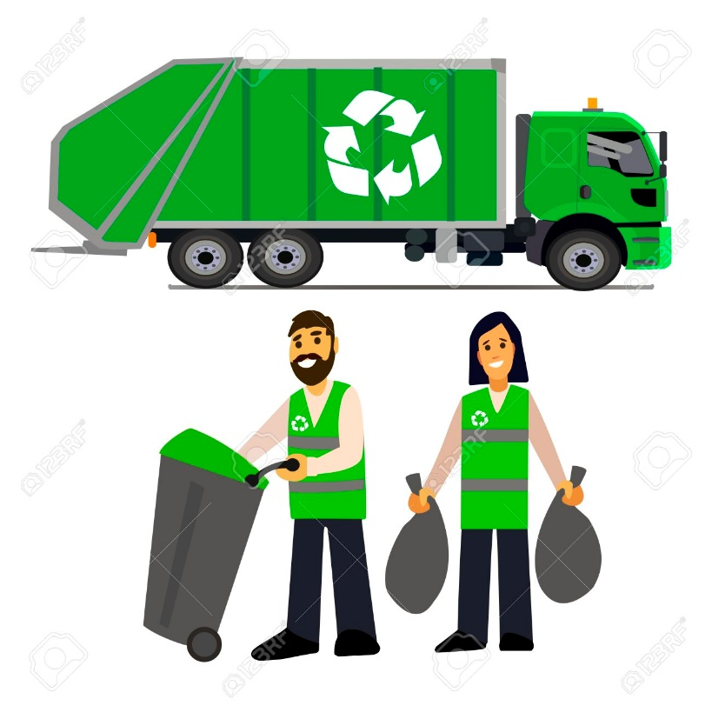
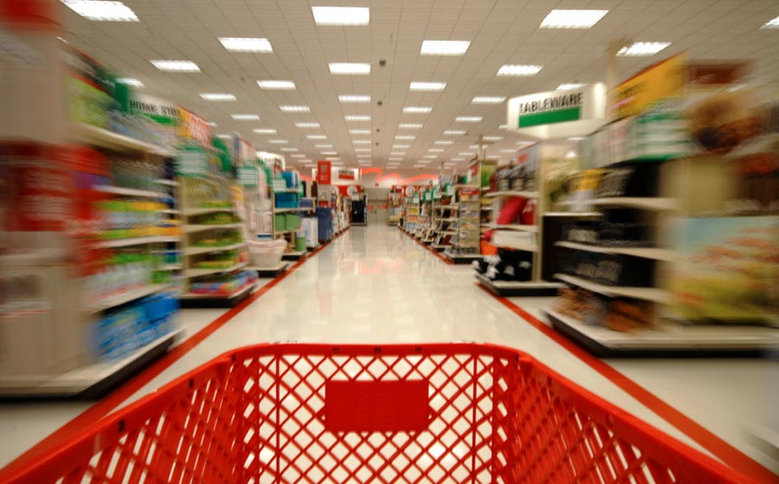
Reduce trash in our streets
Enable people who want to recycle
Convenience

Slide 3
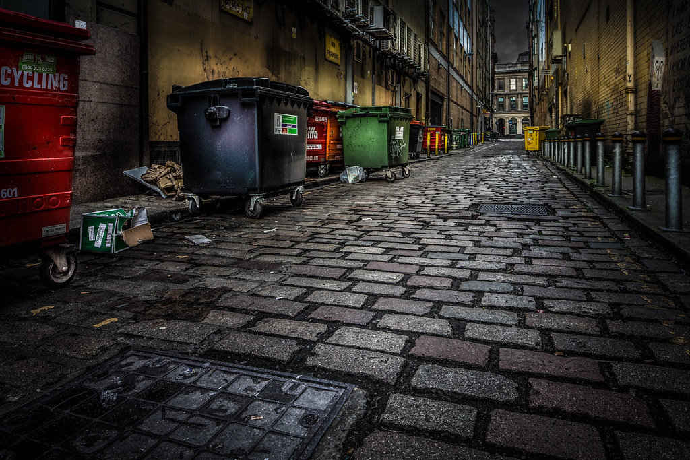
Making a difference with info and organisational support
Locations of bins
Bin full/not
Locations of trash piles

Slide 4
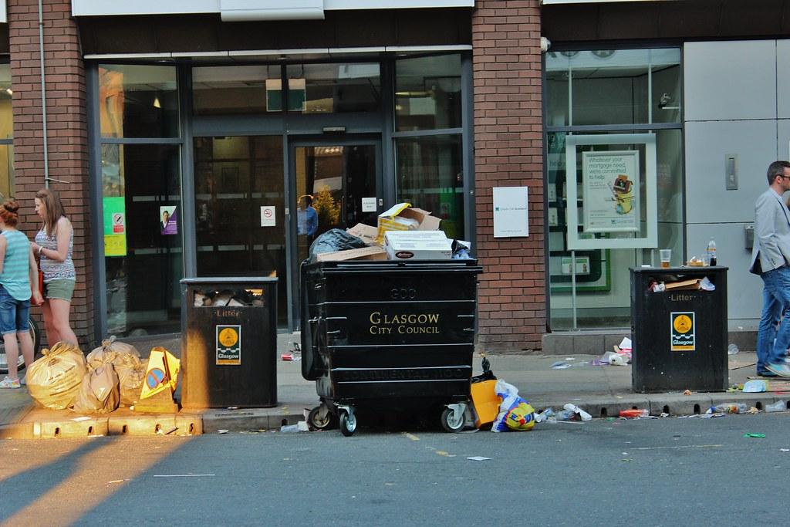
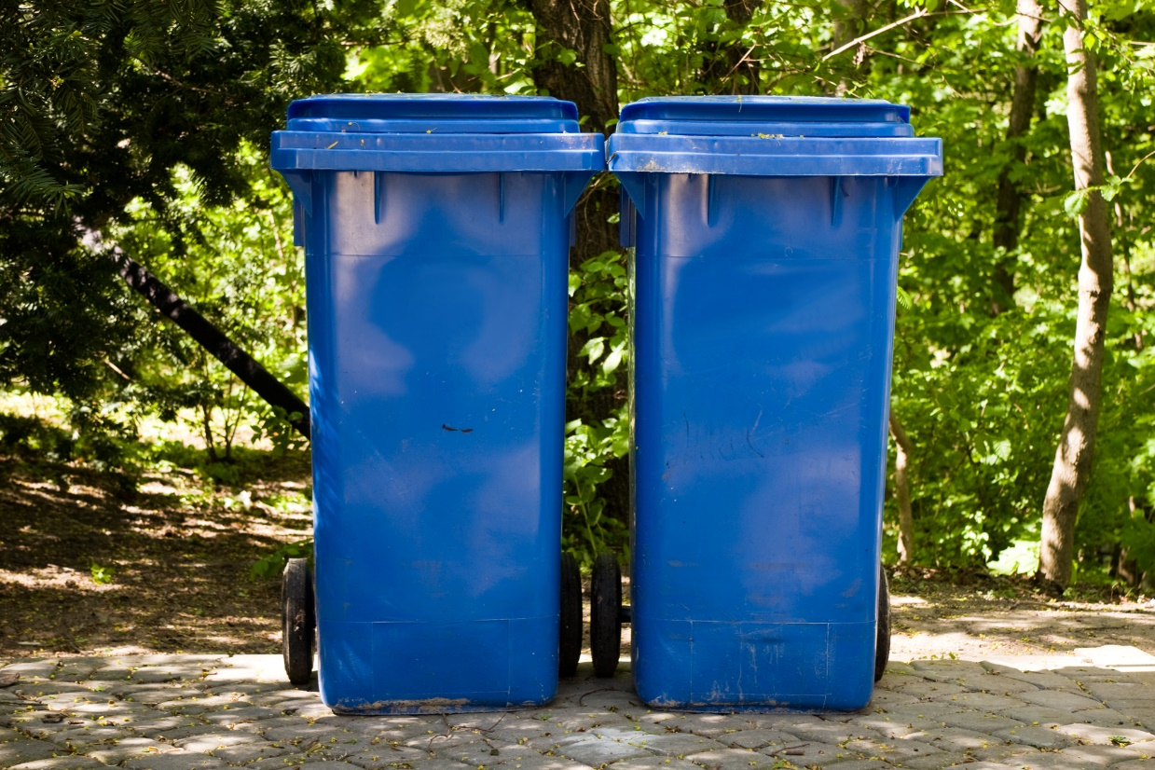

Slide 5
Improvements
Too user oriented
Second stage: involve government
Supply them with analysis to improve trash collection
Encourage user cooperation

Slide 6
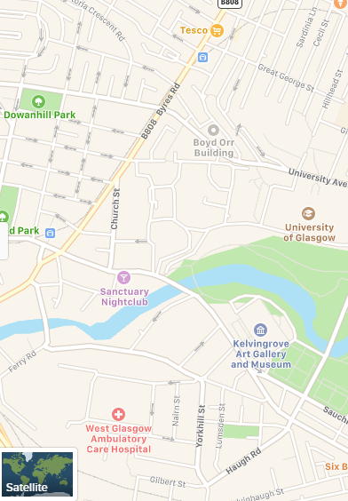





Wireframe
Food waste
Not full ☺

